Slide 1
ASK A MANAGER SALARY SURVEY PRESENTATION
Presented by Abdulrasheed Alhaji Salihu

Slide 2
Which Industry Pays the Most?
ESL Teacher Pay High among all the job according to the dataset.

Slide 3
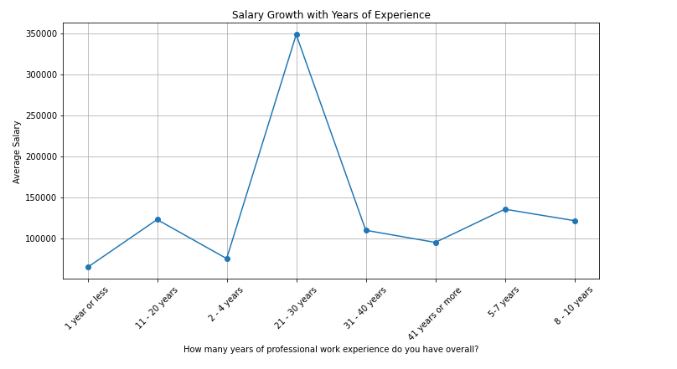
Salary Growth with Years of Experience:
The youth with experience has the highest salary 350,000 USD for 21-30 years.

Slide 4
Geographical Salary Variations:
Indonesia has the highest value 1,050,000,000

Slide 5
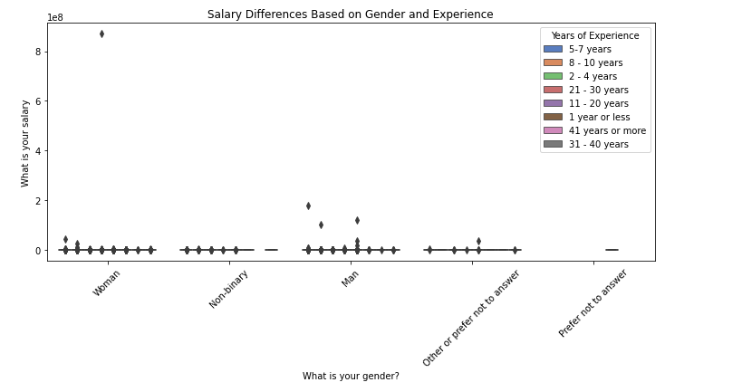
Gender and Experience Impact on Salaries:
Women have the highest salary

Slide 6
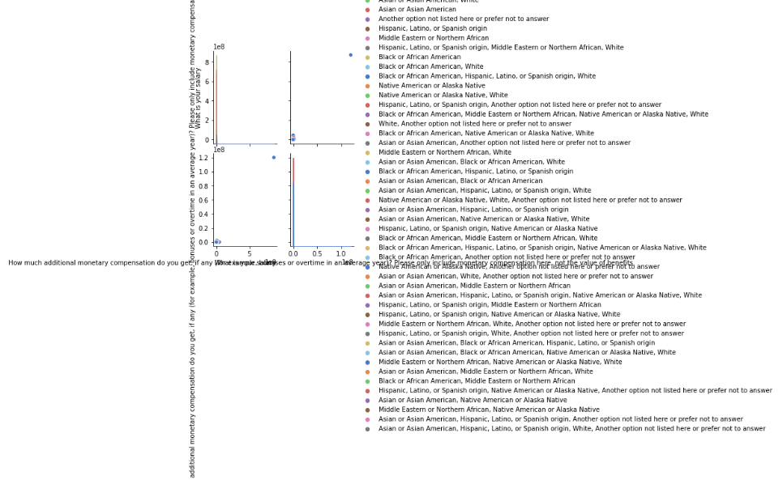
Correlation of Race and Education with Salary:
Black or African American has the highest salary

Slide 7
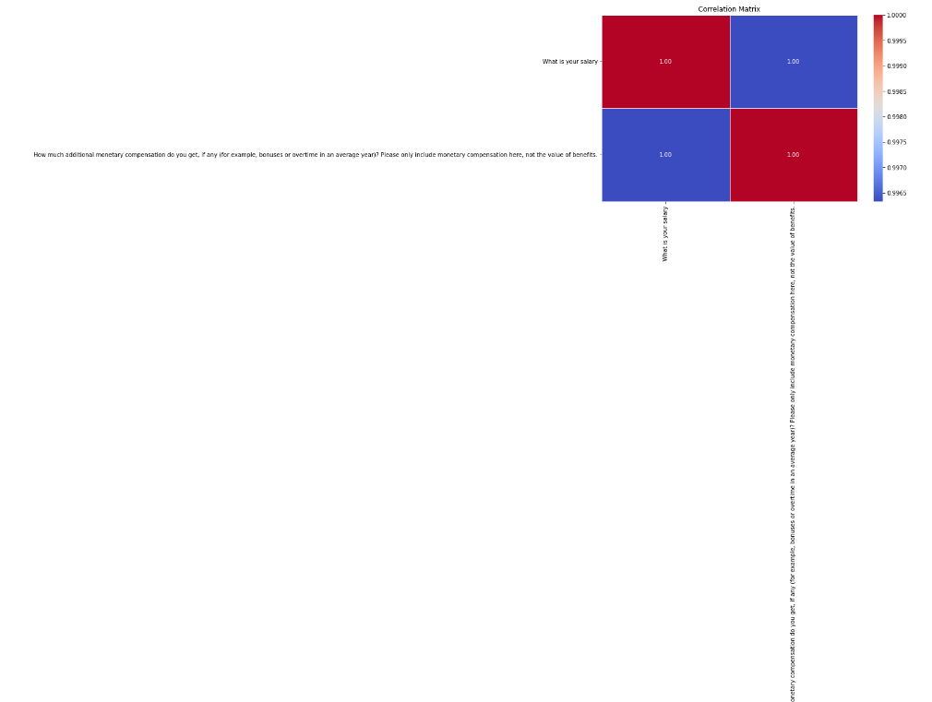
Total Work Experience vs. Field-Specific Experience:

